Slide 1
Interventional Neuroradiology Reflections on 30 years
UKNG 50th Anniversary Meeting
Andrew J Molyneux
Oxford Neurovascular and Neuroradiology Research Unit,
Nuffield Department of Surgical Sciences
University of Oxford

Slide 2
Interventional Neuroradiology From experiment to practice
First use of latex detachable balloons to occlude intracranial vessels and aneurysms by Serbinenko & Schegolov in Russia published in Journal of Neurosurgery in 1974
Gerard De-Brun from Paris brought technology to the West in about 1975 – 1976.
1977 - 1978 Use in Cambridge and Oxford for treatment of direct C- C fistulas: Desmond Hawkins and Philip Sheldon
BK in London

Slide 3
Interventional Neuroradiology What’s Changed?
Everything’s changed ;
Technology the equipment
Techniques
Capabilities Range of diseases treated
Personnel
Organisation
Pressure
Expectation
External Environment

Slide 4
What’s Changed?
Nothing’s changed:
Patients and diseases
Quality and resilience of the Staff

Slide 5
How do we Introduce new devices and technology into NeuroRadiology ?
Regulatory Pathway – Drugs
Phase 1 – 2 Trials, Safety - Efficacy
Phase 3 RCT
Market approval
UK NICE for Cost effectiveness / Benefit
Regulatory Pathway for Devices:
Introduced in the 1990’s
CE Marking – Substantially equivalent to existing approved device
510 K for FDA
Need to show safety and some evidence of efficacy in phase 1 & 2 Trials
No requirement for clinical effectiveness studies
No requirement in Europe for an RCT

Slide 6
The Key figures in the Development of Detachable balloons
Scheglov & Serbinenko Russia and Ukraine 1970’s
Gerard DeBrun Paris, London Ontario, Chicago
Latex detachable balloons
Grant Hieshima, San Francisco
Detachable silicone balloons
Chuck Kerber, San Diego –
Calibrated leak balloon – for delivery of glue to AVM’s
Leopold Plowecki
BALT extrusion – Pursil tubing for intracranial catheterisation 1980 -1981.
Jacques Moret , Paris
Developed any technology to its ultimate technical use!

Slide 7
Who’s Who in Interventional Neuroradiology

Slide 8
Original Detachable Debrun Latex Balloons Attaching the balloon and securing with Latex Thread

Slide 9
The Development and use of Detachable balloons
C-C and other fistulas
Parent Artery occlusion
From about 1978 to 1990’s
e.g. giant cavernous / ICA

Slide 10
Initial supply of balloon devices from Ingenor:
Debrun detachable balloons: 1976 – 1980’s Latex tied on.
Microcatheters – BALT –
Pursil tubing – for Magic type catheters for glue embolisation.
1980 – 1983.
Gold valve latex balloons
Hieshima:
Developed by Interventional Therapeutics (Bill & Julie).
Silicone detachable balloons filled with polymer – HEMA.
Treated a small number of aneurysms with DSB. Risk of aneurysm rupture ! acute and delayed

Slide 11
Treating Carotid cavernous fistula with Latex detachable balloons
TE born 1944
Presented in 1962 at age 18 fell from his motor scooter and sustained a skull base fracture and traumatic CCF.
1962 – 1972
Common Carotid ligation
Internal Carotid Ligation
Craniotomy and Intracranial ICA ligation
Represented 1982

Slide 12
TE at presentation in 1982

Slide 13
Vertebral angio 1982

Slide 14
Operative placement of Left ICA sheath

Slide 15
Post treatment with Debrun latex balloons & IBCA

Slide 16
7 Days post op

Slide 17
1 year follow up

Slide 18
Plain Film 7 Latex balloons 1999

Slide 19
Represented 1999
Developed posterior fossa symptoms small ischaemic event

Slide 20
Presented 2003 with small posterior fossa stroke

Slide 21
CTA 2003

Slide 22
The Development and use of Detachable balloons in Aneurysms
Usage
Trial occlusion & Parent Vessel occlusion and treatment of proximal aneurysms
Intra- aneurysmal use was limited, developed in Soviet Union.
Latex balloons - Jacques Moret in aneurysms – results not published – presented many times
Silicone detachable balloons – Hieshima for aneurysms and proximal vessel occlusion

Slide 23
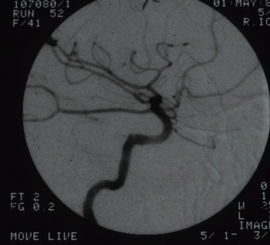
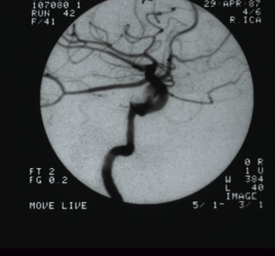
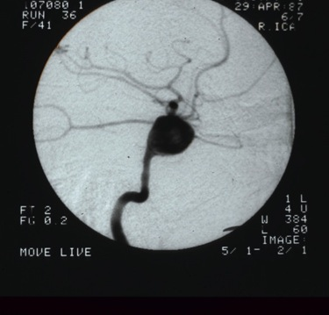
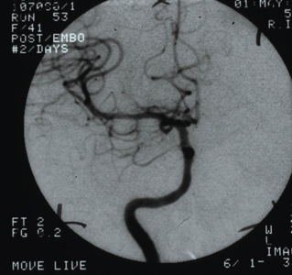
Detachable Silicone Balloon in Large ICA aneurysm

Slide 24
Treatment of a large Basilar Aneurysm with Silicone detachable balloons

Slide 25
Treatment of a large Basilar Aneurysm with Silicone detachable balloons

Slide 26
The development of coils for cerebral aneurysms
Target Therapeutics – 1985 – Spin off of
Advanced cardiovascular systems - ACS
Development of Tracker Catheter by Eric Engelsen
Combined with micro guide wires
Enabled safer and reliable using wire guide catheterisation of cerebral vessels.
To deliver – Particulate embolic and pushable microfibre coils
Used to treat difficult aneurysms pre GDC.
Casasco et al reported 71 patients treated with pushable coils in JNS 1993
Small number of patients treated with pushable coils in Oxford in 1989 - 1990

Slide 27
Various Interventionists

Slide 28
The development of detachable coils for cerebral aneurysms
Late 1980’s
Guido Guglielmi and Ivan Sepetka (Target engineer) & Fernado Vinuela at UCLA.
Developed the Guglielmi Detachable Coil (GDC)
Original idea was working on Electro thrombosis.
Found by accident that the coils detached.
First Clinical use at UCLA in early 1990 – and announced at ASNR in LA that year.
First European use – Oxford June 1992.

Slide 29
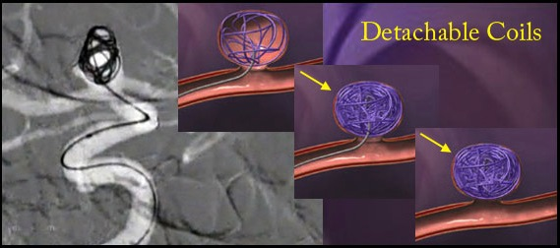
Development of interventional techniques Introduction of Platinum Coils Neuroradiology
1990 First use of a Guglielmi detachable platinum coil GDC to treatment a cerebral aneurysm at UCLA
First use in UK in Oxford June 1992

Slide 30
JW Aged 30
A 30-year-old woman presented with a long history of episodic, severe frontal headache. At the time of admission, the headaches were daily, worse in the morning, lasted up to 10 hours, and lately had been associated with vomiting. Physical examination revealed no abnormality. Contrast-enhanced cranial computed tomography and magnetic resonance revealed a giant basilar tip aneurysm. This was confirmed by vertebral angiography (Fig 1A and B), which demonstrated rapid and rotatory flow within the
aneurysm lumen.

Slide 31
Giant Basilar Aneurysm Treated 1993 Female aged 30 Presenting with headaches
Renowden S & Molyneux AJNR 1995

Slide 32
JW Aged 30
The variable-stiffness catheter was introduced into the aneurysm, and through this catheter five platinum Guglielmi detachable coils (Tracker 18, 8-mm helix by 40-cm length) were inserted sequentially, without complication. The detachment time for four of the coils ranged from 11 to 25 minutes, but the fifth coil had still not detached at 100 minutes. The delivery wire was torqued, and the fifth coil was successfully released.
At this stage the procedure was terminated, and it was estimated that approximately 40% of the aneurysm had been occluded (Fig 1C and D).

Slide 34
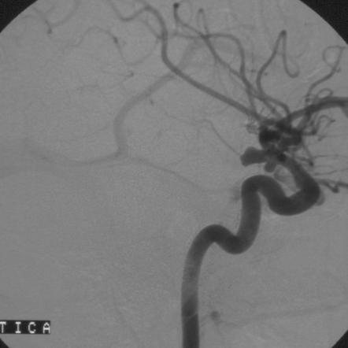

Slide 35
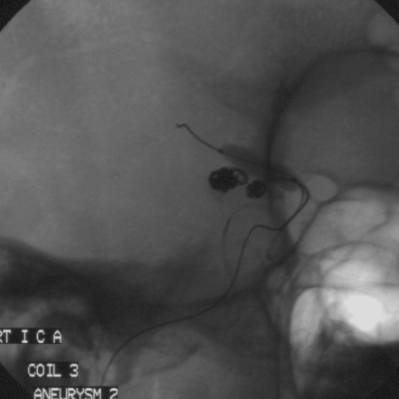

Slide 36
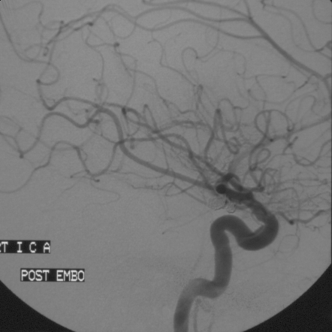

Slide 37
ONYX Liquid aneurysm treatment training 2001 Limoges

Slide 38
Technique
Onyx HD 500
Hyperglide balloon
Rebar microcatheter
Medtronic INX Stents used in 2 patients
All Heparinized/Aspirin and Clopridogel
Graphics courtesy of The Methodist Hospital, Houston, Texas

Slide 39
28 year old haemophiliac with severe headaches

Slide 40
MS Age 28 Haemophiliac - severe headaches

Slide 41
Onyx treatment of basilar aneurysm

Slide 42
Onyx treatment of basilar aneurysm Cast and balloon position

Slide 43
Onyx treatment of basilar aneurysm Immediate post treatment angio

Slide 44
Onyx treatment of basilar aneurysm 3 month Follow up angiogram

Slide 45
Onyx treatment of basilar aneurysm 3 month Follow up angiogram Patient asymptomatic

Slide 46
Female 60 yrs with unsteadiness

Slide 47
Female 60 yrs with unsteadiness

Slide 48
Female 60 yrs with unsteadiness

Slide 49
Female 60 yrs with unsteadiness

Slide 50
Re-treatment 3 months Symptomatically significantly better

Slide 51
Re-treatment 3 months with Neuroform and ONYX

Slide 52
Neuroform in place and 30mm Hyperglide balloon

Slide 53
Post re-treatment tent & ONYX

Slide 54
Pre treatment
Early post treatment
Early post treatment
2 year follow up

Slide 55
2 year follow up Basilar Trunk aneurysm treatment Age 62 Clinically well

Slide 56
ONYX treatment of Broad based ICA aneurysm 45 male with large SAH

Slide 57
ONYX treatment of Broad based ICA aneurysm 45 year old male SAH

Slide 58
Angiogram at 2 weeks

Slide 59
Neuroform stent and Hyperglide balloon

Slide 60
Seal Test with Neuroform Stent & 30mm Hyperglide balloon

Slide 61
ONYC cast after injection cycles

Slide 62
Final Angiogram ONYX & Neuroform

Slide 63
ONYX Liquid Embolic system in treatment of Vascular malformations and aneurysms 4 years experience
Total patients treated 110
Brain AVM 60
Spinal Cord AVM 15
Aneurysms 25
Intracranial Dural AVF 6
Direct Carotid Cavernous fistulas 3
Spinal dural AVM 2
Meningioma 1

Slide 64
Intracranial aneurysms with ONYX Conclusions about 2004
The morbidity and mortality associacted with treatment is not different from that expected with other comlex aneurysm treatment e.g. with stents
The aneurysm occlusion rates are better than the the reported results for coil treatment alone.
The use in combination with stents appears more effective in large and Giant aneurysms
The relationship of this technique to stent and coils is uncertain (esp. Matrix or Hydrogel)
This device may have a role in a small proportion of patients with difficult aneurysms

Slide 65
The Durability of Endovascular Coiling and Neurosurgical Clipping of Ruptured Cerebral Aneurysms.
The long-term risk of recurrent subarachnoid haemorrhage, dependency and death and standardised mortality ratios after coiling and clipping of a ruptured intracranial aneurysm.
18-year follow-up of the UK cohort of the International Subarachnoid Aneurysm Trial (ISAT)
The Lancet
Published on Line 28th October 2014
Vol:385, p691-697 21st February 2015
Correspondence – 6th June 2015
AJ Molyneux, J Birks, A Clarke, M Sneade, RSC Kerr

Slide 66
What is the probability of being alive at 10 years and having a favourable Rankin score ?
68.2 % of UK endovascular patients in ISAT were alive and independent
61.7 % of the Neurosurgical patients were alive and independent.
Odds ratio: 1.335 (95% CI 1.085 to 1.643)
Statistically significantly more likely to be alive and independent at 10 years after coiling allocation

Slide 67
What are the Causes of Death in UK Cohort?
1644 patients enrolled
16579 person years of follow-up up to 17.6 years
A total of 389 deaths amongst the cohort
140 patients died in the first year.
249 patients have died during the period of follow-up period after one year
6 died from the treated aneurysm
4 endovascular and 2 Neurosurgery
9 deaths due to rupture of another aneurysm
232 have died of causes other than a SAH.
Mostly cancer and cardiovascular disease

Slide 68
Lancet 2015 Conclusions
Interpretation:
The 10-year mortality was significantly greater in the neurosurgical group. There is an increased risk of recurrent bleeding from a coiled aneurysm compared with a clipped aneurysm but the risk is small and, very importantly, the clinical benefit in respect of disability free survival in patients allocated endovascular coiling observed at one-year is maintained at 10 years.

Slide 69
ISAT 10 - 18 year outcomes Conclusions
Research in Context
Interpretation:
ISAT results have changed worldwide clinical practice and the study is very unlikely to be repeated.
This paper shows that the durability of coil treatment and the clinical benefit of coiling that was observed at one year are maintained at 10 years. The risk of death and re-bleeding from the treated aneurysm, up to 18 years, in both groups is very small and similar to the risk of recurrent haemorrhage from another aneurysm.
All patients have an increased standardised mortality ratio (1.40) compared with the general population but they are far more likely (40 times) to die as a result of causes other than the treated aneurysm; mainly cancer or cardiovascular disease.
This emphasises the importance advice about lifestyle factors, particularly smoking and control of hypertension, in these patients.

Slide 70
US practice in Unruptured Aneurysms treatment - AJNR 2010
RESULTS: The fraction of unruptured aneurysms treated with coiling increased from 20% in 2001 to 63% in 2008. For surgical clipping, the percentage of patients discharged to long-term facilities was 14.0% (4184/29,918) compared with 4.9% (1655/34,125) of coiled patients (P < .0001). Clipped patients also had a higher mortality rate because 344 (1.2%) clipped patients died compared with 215 (0.6%) coiled patients (P < .0001). Between 2001 and 2008, the overall number of adverse outcomes from treatment had decreased from 14.8% to 7.6%.

Slide 71
Final Messages to young INR’s
KISS principle:
Keep It Simple and Safe. Christopher Adams “A Neurosurgeons Handbook”
Do not pursue angiographic perfection at the risk of a higher complication rate
Simple coiling works
Do not always be seduced by the latest technology
When have a hammer everything looks like a nail
Continued follow-up of patients if 6 month F/U is OK is probably not needed
Remember the objective –
preventing re-bleeding
not a perfect picture
Treat patients – Not Angiograms or Scans !

Slide 72
Thanks to all the investigators who have supported the ISAT study for such a long time
But especially thanks to all the patients and their relatives who agreed to participate and made all these studies possible
High quality procedural Randomised trials are possible in Radiology !

